Slide 1
Halloysite
The success of halloysite as an emerging nanomaterial is explained by its low toxicity, biocompatibility, tubes’ high aspect ratio, empty inner cavity and different inner-outer surface chemistry.
From the mineralogical view- point is a naturally-occurring
two-layered aluminosilicate (1:1), characterized by a hollow tubural structure.
Its is cheap, easy available, eco-friendly, abundant and durable.

Slide 2
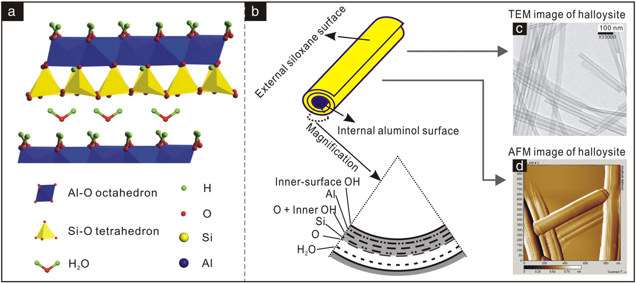
Its size depends from the deposit and varies from 50 to 70 nm in external diameter and 10 to 20 nm diameter for the lumen. The tubes’ lenghts range within 0.5-1.5 µm and their walls are formed by the rolling of 15-20 aluminosilicate layers.
The presence of water molecules in the interlayer determines a decrease of the spacing in the multilayer walls from 1 to 0.7 nm.

Slide 3
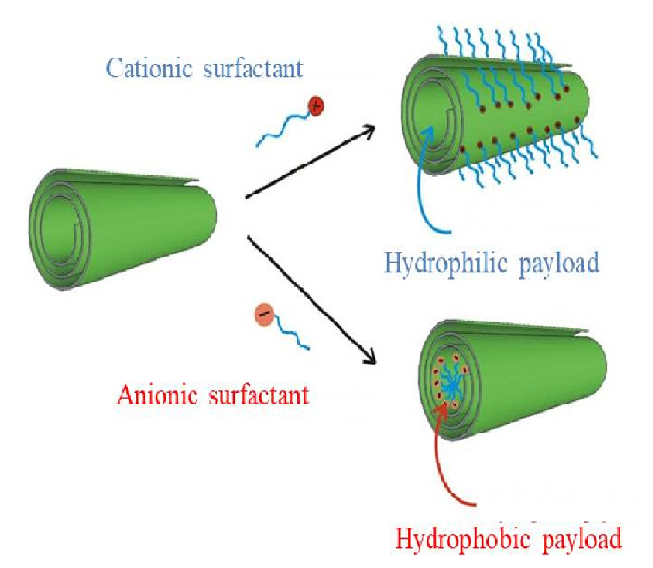
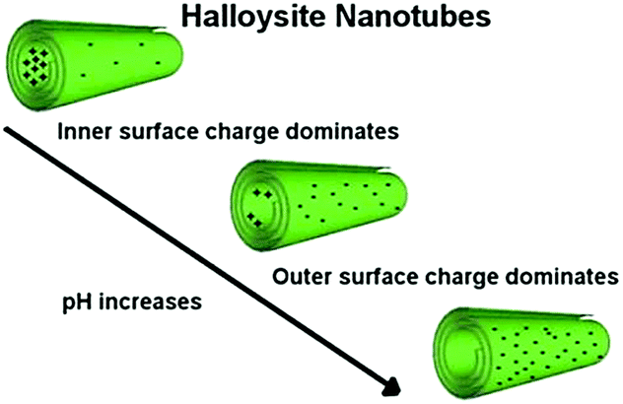
The Halloysite particular structure allows it several intristing elottrostatics interactions:

Slide 4
pH sensitive:
The surface charge of Halloysite was estimated by ζ potential measurements as a function of pH.
In each nanotubes,the inner surface is positively charged bacause of protonation of AlOH groups at low pH.
Instead, at pH higher than 2, the gradual deprotonation of SiOH grups causes an excess of negative charges on the outer surface.
The numerous hydroxyl groups of Halloysites together with their particular dispotition in the inner and the outer surfaces of the nanotubes make very difficult the study of acid-base properties of this material.

Slide 5
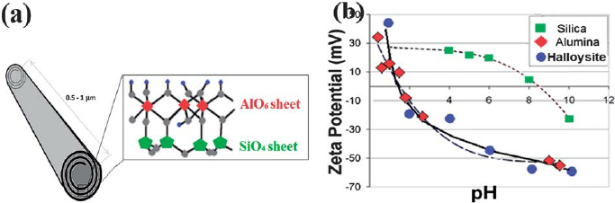
ζ potential:
The surface of nanotubes Halloysite is mainly silica, the surface charge will be negative over a wide range of pH, as is evidente in the ζ potential plot.
As a result, Halloysite tends to have a polyanionic surface, exept at very low pH.

Slide 6
The special chemistry structure of Halloysite nanotube makes it very interesting…
Halloysite has several application:
Inorganic nanofiller for polymeric matrix (NANOCOMPOSITS);
Food packaging;
Catalyzer;
DRUGS DELIVERY;

Slide 7
Drug delivery :
One of the most interesting application of Halloysite is as drug delivery pH sensitive.
Various works proves that Halloysite is a great drug delivery with controled relaese.
Nanotubes of Halloysite were studied with drugs like Insuline, antifungal , anti-cancer drugs and many others.
The functionalization of both sufaces of nanotube is useful to make new more resistance materials and to introduce several functions on the nanoparticles surfaces, like:
Colours
Smells

Slide 8
IThanks to its special distribution of opposite charge on its surfaces and to its special behaviour as drug delivery, Halloysite has become very famous and intristing in several fields.
Computational chemistry allows us to build
and study systems with behaviours that aren’t easy to explain in the experimental way.
I worked with Molsim program, to built a system and to study the elettrostatics interactions between a nanotube of Halloysite and other particles.h

Slide 9
During my interschip I learned the basis of Molsim using the Monte Carlo method to analize some systems
MONTE CARLO METHOD
Monte Carlo method is a statistical sampling technique that has been applied to several number of scientific problems. It is appropriate for calculating thermodinamic quantities or for performing simulated annealing calculation.
With Monte Carlo method is possible to study systems in equilibrium.
You can collect information on the ensamble.

Slide 10
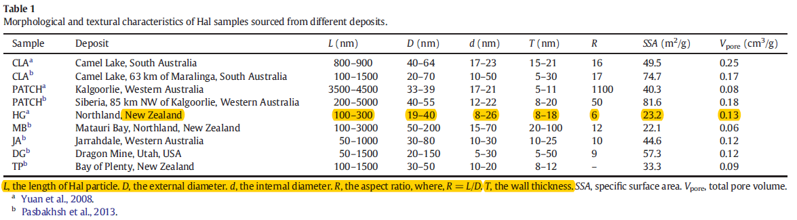
To study a stystem as real as possibile, we used data about Halloysite parameters from literature paper :
Table 1 : Peng Yuan, Daoyong Tan , Faïza Annabi-Bergaya, Applied Clay Science 112–113 (2015) 75–93

Slide 11
In order to study different cases we changed the parameters of our system according to literatur data. In this way we are able to understand how the dimention, the shape and the charge of the nanopaticles influences the interaction with the other particles of the system.
Cell dimention : Cylrad: Cylindrical cell radius : 800 Å
Cyllen: Cylindrical cell lenght : 1200 Å
Number of macrosteps and steps : 10 and 10000
Particles variables : Number, Type, Atom types, Radat : atom radius (2.0 Å) ,
Zat : Atom charge
Nanotubes variables : rcap: Nanotubes radius : 60 Å
dcap: Nanotubes thickeness : 100 Å, 180 Å , 240 Å, 500 Å
lcap: Nanotubes lenght : 700 Å

Slide 12
Our systems
Nanotube and counterions :
Different density charge Al-Si:
1:4 (2)
Increasing dcap
Nanotube and counterions :
Same density charge Al-Si:
1:1
Increasing dcap
Nanotube and polyampholyte
(2) Clemente Bretti, Salvatore Cataldo, Antonio Gianguzza, Gabriele Lando, Giuseppe Lazzara,
Alberto Pettignano and Silvio Sammartano. J. Phys. Chem. C 2016, 120, 7849−7859

Slide 13
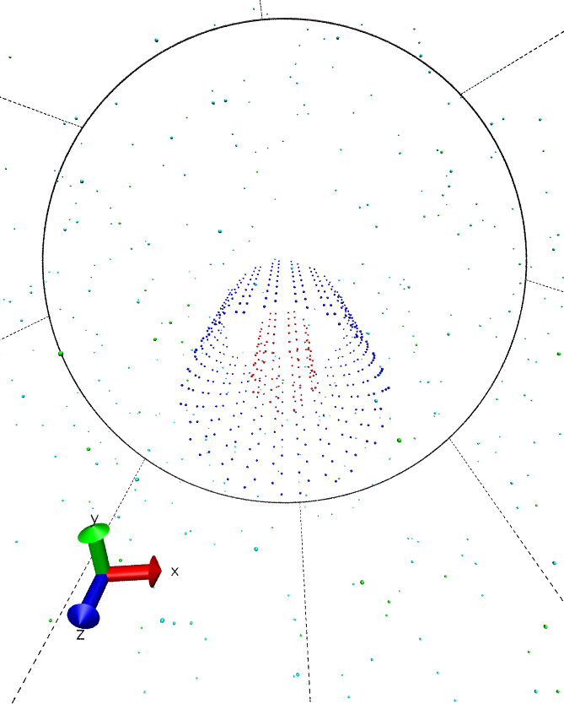
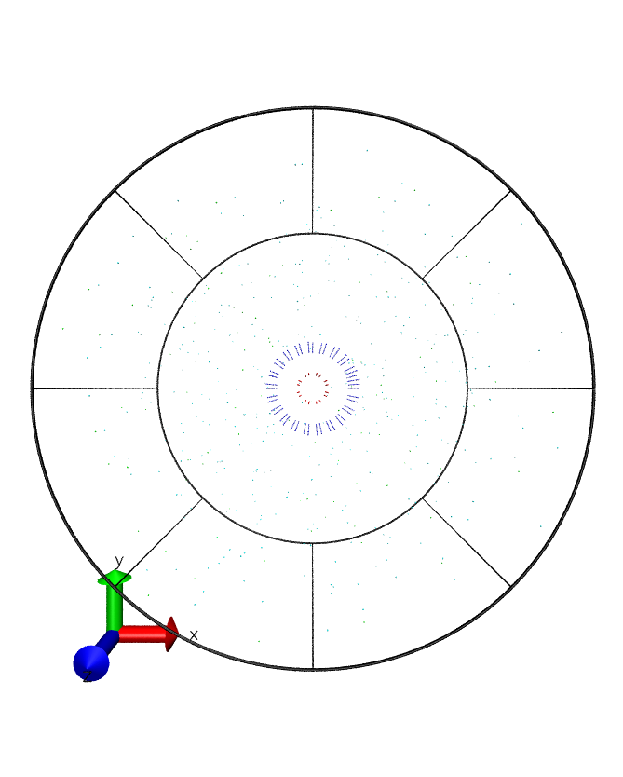
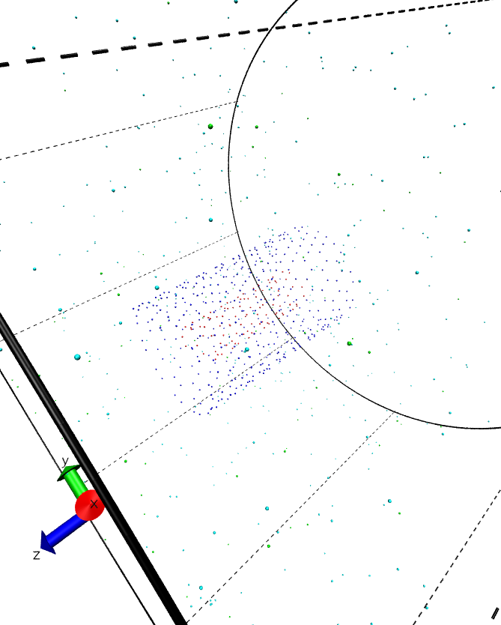
dcap 100
Al : Si 1:4
pH 2
Nanotube and counterions

Slide 14
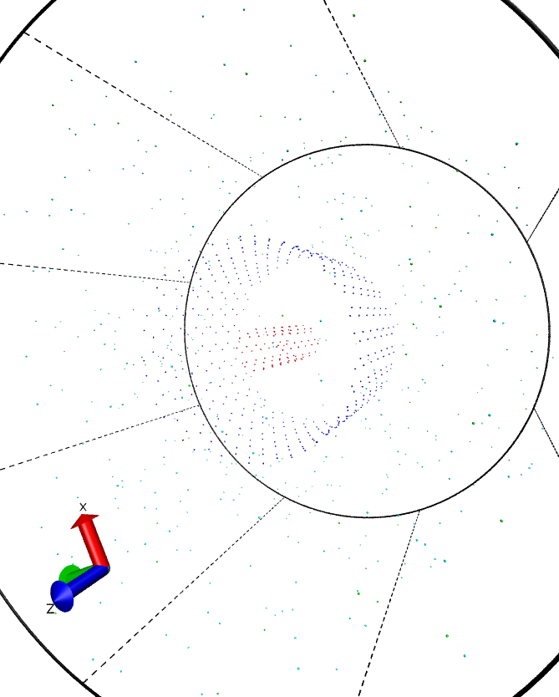
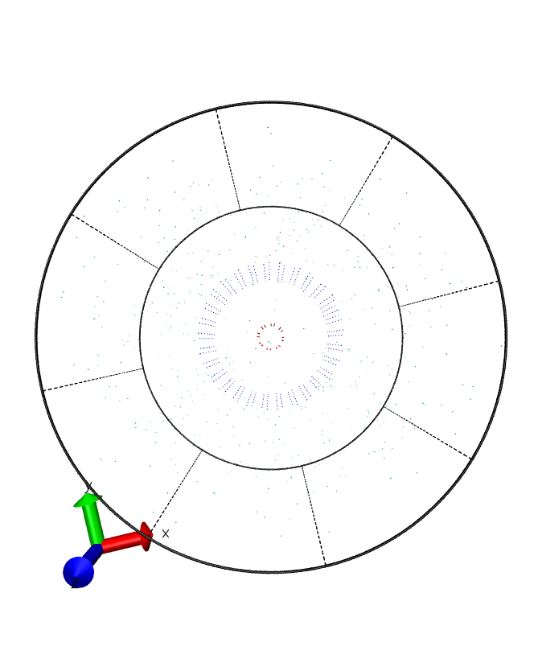
dcap 240
Al : Si 1:4
pH 7

Slide 15
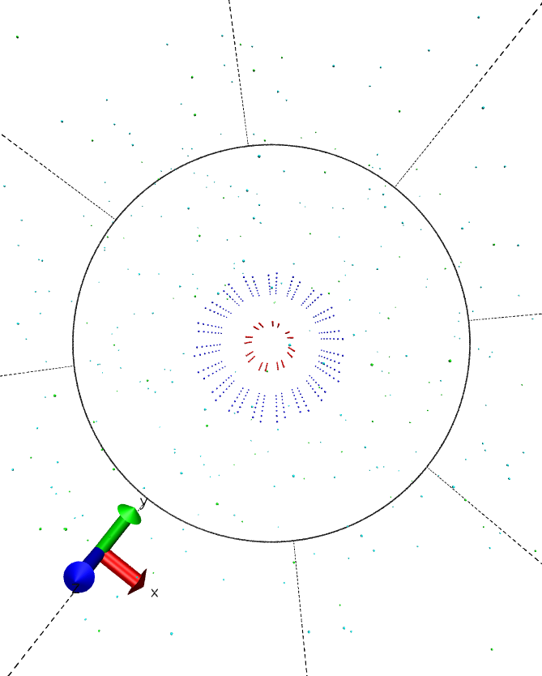
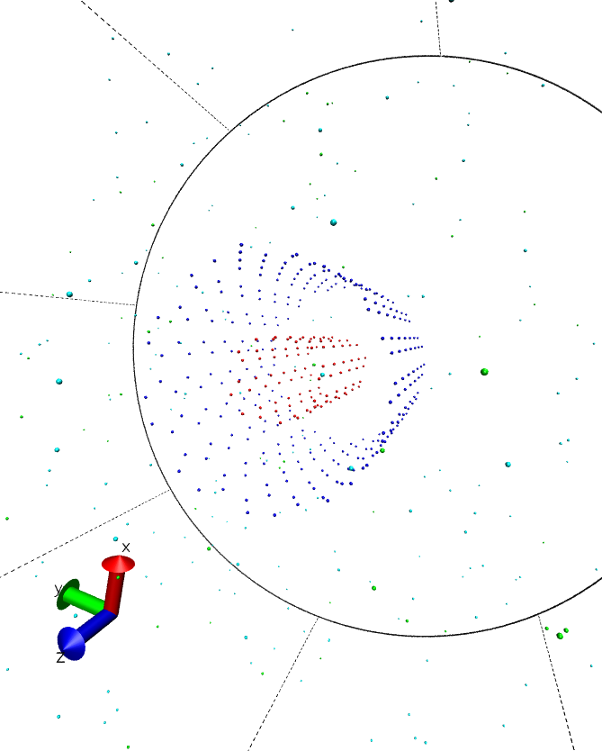
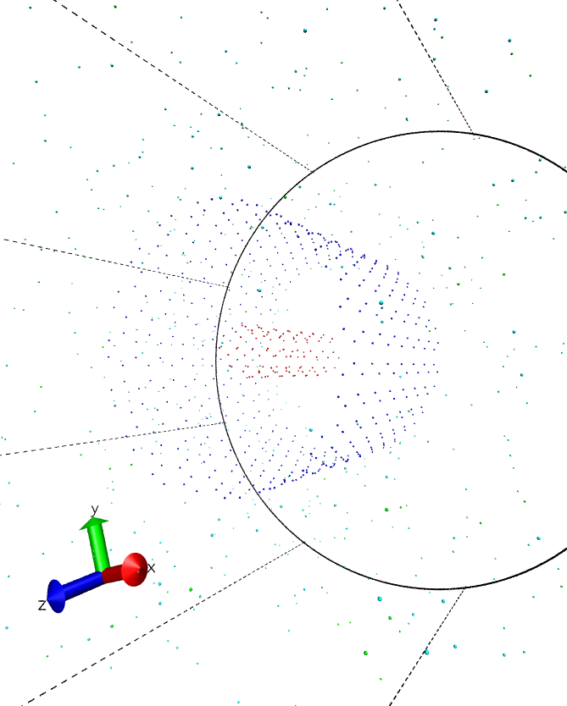
Nanotube and counterions
dcap 240
Al : Si 1:1
pH 6
dcap 100
Al : Si 1:1
pH 2

Slide 16
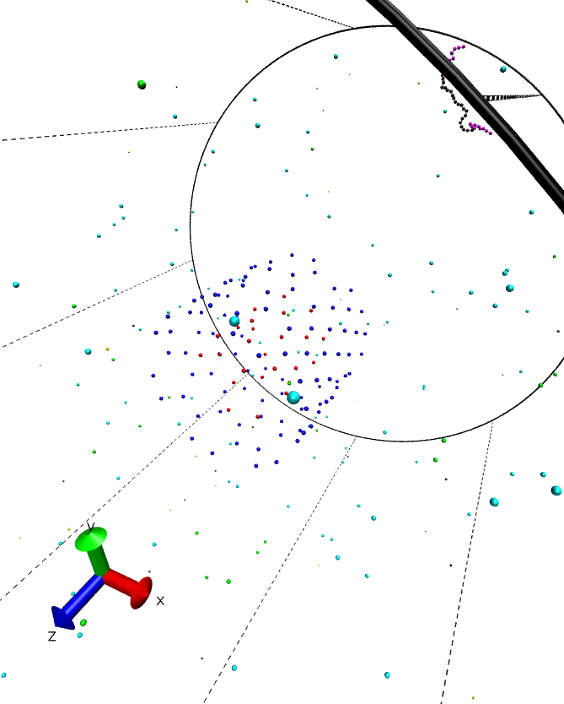
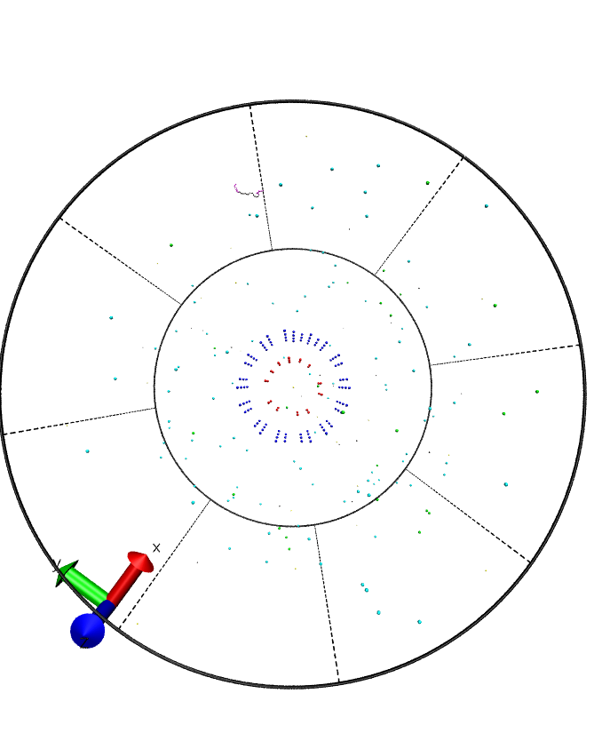
Nanotube and polyampholyte
pH2

Slide 17
Titration
Titration of a system with only Al particles.
rcap 60 Å
Titration of a system with only Si particles.
rcap 240 Å

Slide 18
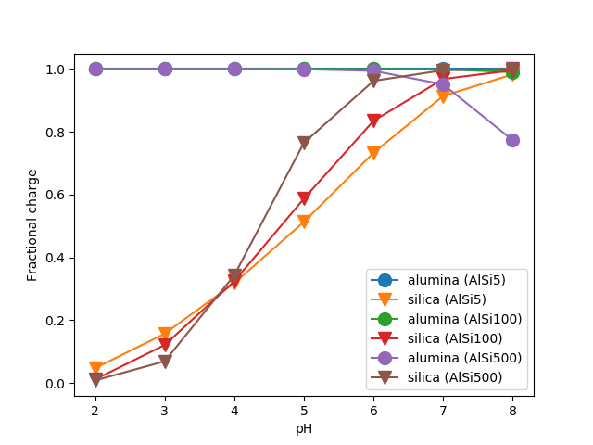
Titration of three systems with different thickness (dcap) :
5 Å, 100 Å, 500 Å
By changing the thickness of nanotube is possible to see how the dcap influences the titration.
Increasing the thickeness the interactions between Al and Si particles is weaker and the titration became more slow and easy.
The titration curve of the 500 Å dcap system looks like the titration curve of the systems of Al and Si alone without mutual interections.

Slide 19
Thank you
for your attention!
Costanza Tedesco

